Slide 1
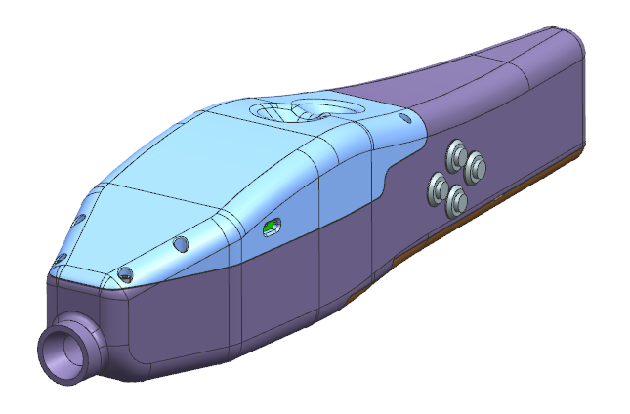
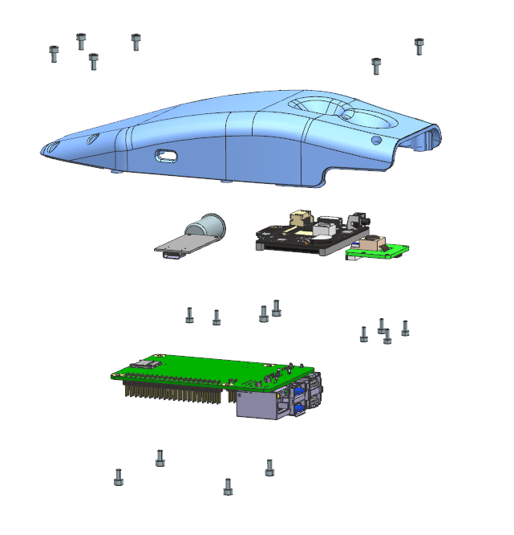
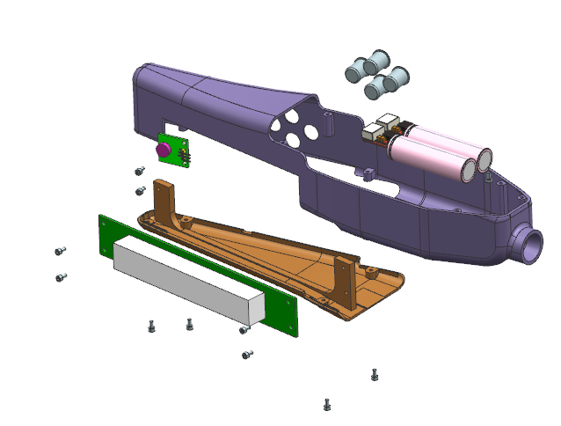
제품 설계/조립도
<Upper module>
<Lower module>
4 x M2.5-5mm
2 x M2.5-5mm
Select button
Upper cover
2 x 5V step down module
vibration module
7.4v Li-Po battery
2 x M2.5-5mm
Power switch
Husky camera
C type charging port
Raspberry camera module
Lower cover
2 x M2-5mm
2 x M2.5-5mm
2 x M2-5mm
2 x M2.5-5mm
Botton cover
Dot module`
2 x M2.5-5mm
2 x M2.5-5mm
4 x M2.5-5mm
2 x M2.5-5mm

Slide 2
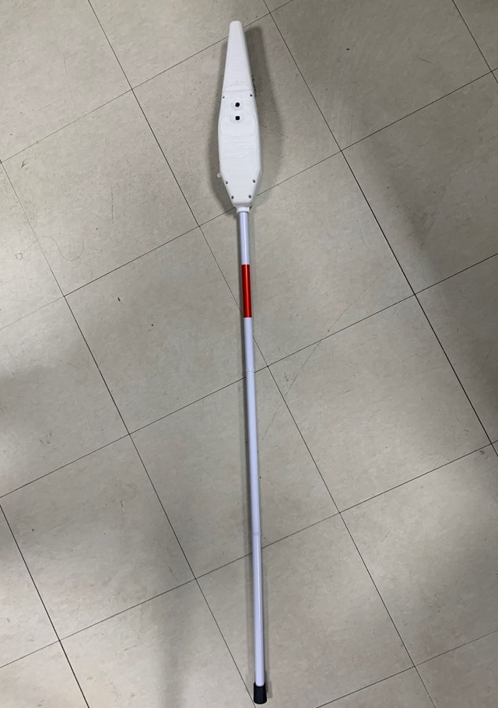
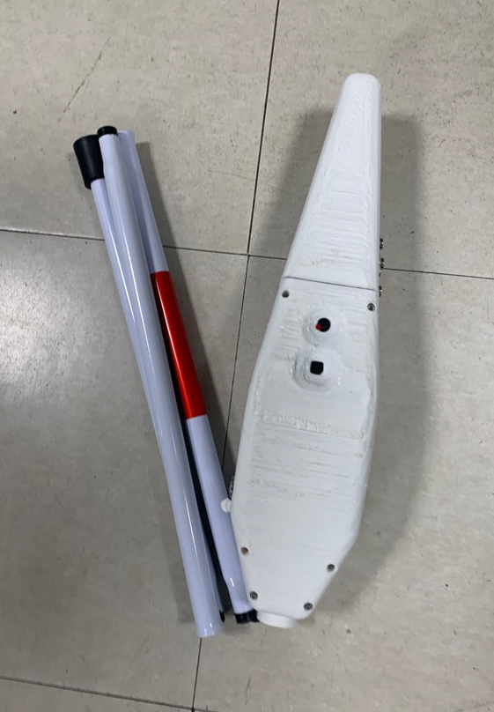
제품 설계/조립도
Weight | 1.2kg (including cane)
Dimensions | Total | 150 x 380 x 80mm
 | folded | 150 x 1250 x 80mm
Service | 1. Traffic light recognition
 | 2. Currency recognition 3. IoT - Face recognition - Home appliance control
Actuation | Dot feedback haptic feedback
Electronics | Raspberry Pi 4 7.4v Li-Po battery 2200mAh 5V USB C type charging
<개발된 디바이스>

Slide 3
제품 설계/조립도
 | 품명 | 품번 | 수량 | 비고
1 | Upper cover | - | 1 | 3D 프린팅
2 | Lower cover | - | 1 | 3D 프린팅
3 | Bottom cover | - | 1 | 3D 프린팅
4 | Power switch | HX12-A5 | 1
5 | C type charging module | HAM5005 | 1
6 | Raspberry camera module | - | 1
7 | Husky camera | - | 1
8 | vibration module | ICF1383 | 1
 | 품명 | 품번 | 수량 | 비고
9 | Select button | HX12-C4 | 4
10 | 5V step down module |  | 2 | https://smartstore.naver.com/zxmas1005/products/5666703065?NaPm=ct%3Dl7fkqljc%7Cci%3Dcheckout%7Ctr%3Dppc%7Ctrx%3D%7Chk%3Daa0e235eecaabf0e054f6a0801d486bfff9ea62f
11 | 7.4v Li-Po battery |  | 1
12 | Dot module |  | 1
13 | M2.5 bolt 5mm |  | 22
14 | M2 bolt 5mm |  | 6
15 | Cane |  | 1 | https://smartstore.naver.com/momo2000/products/4858337603?NaPm=ct%3Dl7fkq4li%7Cci%3Dcheckout%7Ctr%3Dppc%7Ctrx%3D%7Chk%3D4dac3cc09b777cc672391d91d16e9181d3349e4e

